Slide 1
We're here for you. Ask us anything at GPCAH.org.
Notes:
Concerned about health and safety on the farm? Visit GPCAH.org and contact us with your questions. #farmers #COVID19 #farmsafety #USAgCenterSafety #agsafetytips #coronavirus

Slide 2
COVID-19 SYMPTOMS
Fever
Cough
Shortness of breath
OR AT LEAST 2 OF THESE
Headache
Chills
Repeated shaking with chills
Muscle pain
Sore throat
New loss of taste and smell
Source: CDC Agricultural Industry Guidance
Notes:
COVID-19 is a respiratory illness caused by a new virus called SARS-CoV-2. Do you and your employees know the symptoms? #COVID19 #farmsafety #USAgCenterSafety #agsafetytips #coronavirus

Slide 3
COVID-19 is spread from person-to-person through respiratory droplets.
Source: CDC Agricultural Industry Guidance
Notes:
COVID-19 can spread when a person talks, coughs, or sneezes. Avoid touching shared surfaces and then touching your mouth, nose, eyes. #COVID19 #farmsafety #USAgCenterSafety #agsafetytips #coronavirus

Slide 4
What's your plan?
Source: CDC Agricultural Industry Guidance
Notes:
Use new CDC guidelines for ag to develop a COVID-19 health and safety plan for your
workplace. Learn more at https://bit.ly/2TG74V6. #COVID19 #farmsafety #USAgCenterSafety #agsafetytips #coronavirus

Slide 5
Are farmers at risk of developing COVID-19? Yes!
Source: CDC/Agricultural Industry Guidance
Notes:
Farmers often work closely together both indoors and out. Prolonged close contact with potentially infected coworkers increases the risk of developing COVID-19. #COVID19 #farmsafety #USAgCenterSafety #agsafetytips #coronavirus

Slide 6
COVID-19 adds stress and challenges to busy farmers, but rushed decisions can harm your safety and health.
Source: CDC/Agricultural Industry Guidance
Notes:
Before doing a task, take a moment to stop, think, and act for safety. https://bit.ly/2ZsvHbF #COVID19 #farmsafety #USAgCenterSafety #agsafetytips #coronavirus

Slide 7
Source: CDC Agricultural Industry Guidance
Notes:
Physical distancing on the farm: Reduce crew sizes; stagger work shifts, mealtimes, and breaks; alternate field rows; and remain 6-feet apart. Consider alternating normal shift schedules so workers are always around the same coworkers. #COVID19 #farmsafety #USAgCenterSafety #agsafetytips #coronavirus

Slide 8
Install shields or barriers, such as plexiglass, between farmworkers
Encourage farmworkers to wear cloth face coverings
Source: CDC Agricultural Industry Guidance
Notes:
When a 6-foot distance between farmworkers is not possible the CDC guidelines suggest the following options:
#COVID19 #farmsafety #USAgCenterSafety #agsafetytips #coronavirus

Slide 9
Don't forget to wear gloves when cleaning and disinfecting.
Source: CDC Agricultural Industry Guidance
Notes:
Use gloves made of lightweight nitrile or vinyl, or heavy-duty rubber work gloves that can be disinfected. #COVID19 #farmsafety #USAgCenterSafety #agsafetytips #coronavirus

Slide 10
Consider allowing your farmworkers to voluntarily
use filtering-facepieces respirators (such as an
N95 or stronger, if available).
Source: CDC Agricultural Industry Guidance
Notes:
Farmworkers may also need gloves, face protection, and eye protection when cleaning and disinfecting. #COVID19 #farmsafety #USAgCenterSafety #agsafetytips #coronavirus

Slide 11
Cloth face coverings will not protect you from being exposed to COVID-19. They only help contain your respiratory droplets from spreading to others.
Cloth face coverings may increase the risk of heat-related illnesses, so drink more water, make water easily available, and take more breaks as appropriate.
Source: CDC Agricultural Industry Guidance
Notes:
What if I don't have access to an N-95 respirator? Wear clean cloth face coverings (even when physical distancing). #COVID19 #farmsafety #USAgCenterSafety #agsafetytips #coronavirus

Slide 12
Clean your face coverings after each use. Contaminated cloth face coverings should be removed in a safe manner and disposed of or regularly cleaned in a washing machine after each use.
Source: CDC Agricultural Industry Guidance
Notes:
Don't share cloth face coverings among workers unless adequately laundered between uses. #COVID19 #farmsafety #USAgCenterSafety #agsafetytips #coronavirus

Slide 13
Cover coughs and sneezes with tissue.
Throw used tissues away immediately.
If you don't have a tissue, cough or sneeze into your elbow, not your hands.
Source: CDC Agricultural Industry Guidance
Notes:
Help contain the virus by preventing the spread of germs. Follow us for the latest recommendations on COVID-19 safety. #farmers #COVID19 #farmsafety

Slide 14
Add extra
handwashing stations and make hand sanitizers, cloth face coverings or masks, and
disposable gloves available and accessible.
Add extra handwashing stations and make hand sanitizers, cloth face coverings or masks, and disposable gloves available and accessible.
Source: CDC Agricultural Industry Guidance
Notes:
Make it easy for farm workers to protect their health and safety on the job. https://bit.ly/handwashing42. #COVID19 #farmsafety #USAgCenterSafety #agsafetytips #coronavirus

Slide 15
BEFORE eating food or touching your eyes, nose, or mouth.
BEFORE and AFTER treating a cut or wound.
AFTER
using the toilet
blowing your nose, coughing, or sneezing
touching an animal, animal feed, or animal waste
you've been in a public place
you've touched something often touched by other people (doorknobs, equipment, etc.).
Source: CDC Agricultural Industry Guidance
Notes:
When should I wash my hands or use sanitizer with at least 60% alcohol?
#COVID19 #farmsafety #USAgCenterSafety #agsafetytips #coronavirus

Slide 16
Help avoid the spread COVID-19: do not share tools.
Source: CDC Agricultural Industry Guidance
Notes:
To prevent the spread of COVID-19, limit any sharing of equipment and tools. If you
must share tools, clean and disinfect them first. https://bit.ly/EPA-disinfect. #COVID19 #farmsafety #USAgCenterSafety #agsafetytips #coronavirus

Slide 17
Clean and disinfect locker rooms and other shared spaces at the end of each shift. Also clean and disinfect break areas after each use (and at least once a day).
Source: CDC Agricultural Industry Guidance
Notes:
Keep shared spaces clean! Follow us for the latest recommendations on COVID-19 safety. #COVID19 #farmsafety #USAgCenterSafety #agsafetytips #coronavirus

Slide 18
Use disposable disinfectant wipes (and required PPE) to frequently wipe down touched surfaces.
Source: CDC Agricultural Industry Guidance
Notes:
Keep shared spaces clean! Follow us for the latest recommendations on COVID-19 safety. #COVID19 #farmsafety #USAgCenterSafety #agsafetytips #coronavirus

Slide 19
Explain to your workers
what types of PPE to use and when to use them
how to put PPE on and take it off
how to correctly dispose of or clean PPE
how to change damaged PPE
how to wash hands for 20 seconds in warm water after touching PPE
Source: CDC Agricultural Industry Guidance
Notes:
Training workers during an epidemic is a new thing! Use PPE training videos or in-person demos (don't forget to physically distance).
Ensure PPE is used properly by all farmworkers. #COVID19 #farmsafety #USAgCenterSafety #agsafetytips #coronavirus

Slide 20
Tell sick employees to go home, self-isolate, and call their doctor or hospital.
Source: CDC Agricultural Industry Guidance
Notes:
Sick employees should restrict exposure to animals and pets. If personnel needs to be within 6 feet of a sick coworker, appropriate PPE should be used. #COVID19 #farmsafety #USAgCenterSafety #agsafetytips #coronavirus

Slide 21
Move necessary meetings online or outdoors as appropriate
Stagger employee shifts and breaks
Limit team sizes and rotations
Limit the sharing of equipment and tools
[link CDC guidelines]
Source: CDC Agricultural Industry Guidance
Notes:
Farm workers: limit the spread of COVID-19 by taking these steps:
#COVID19 #farmsafety #USAgCenterSafety #agsafetytips #coronavirus

Slide 22
Keep children out of the worksite.
Source: CDC Agricultural Industry Guidance
Notes:
Taking a child into the worksite not only exposes them to hazards like chemicals and equipment, but also can distract workers and lead to incidents. #COVID19 #farmsafety #USAgCenterSafety #agsafetytips #coronavirus

Slide 23
The CDC states, “Taking a child into the worksite not only exposes them to the hazards in the environment, but also distracts the worker from their tasks, increasing the risk of injury for both the child and the adult.”
Source: CDC Agricultural Industry Guidance
Notes:
Did you know The CDC has issued guidance to protect farm owners, operators, workers and families from Coronavirus Disease 2019 (COVID-19)? If possible, continue sending your children to childcare while you are working at the farm. For more information visit https://www.cdc.gov/coronavirus/2019-ncov/community/schools-childcare/guidance-for-childcare.html. #farmers #COVID19 #farmsafety #USAgCenterSafety #agsafetytips #coronavirus

Slide 24
If youth workers are hired or working on your farm, assign age appropriate tasks.
Source: CDC Agricultural Inudstry Guidance
Notes:
Most children are home now because K-12 schools, childcare and summer programs have been shutdown or canceled because of Coronavirus Disease 2019 (COVID-19). However, the CDC says: “even when homes and worksites overlap, continue to restrict children from the worksite.” Here are some great guidelines. https://cultivatesafety.org/safety-guidelines-search/ #farmers #COVID19 #farmsafety #USAgCenterSafety #agsafetytips #coronavirus

Slide 25
Do you employ young people on your farm?
Source: CDC Agricultural Industry Guidance
Notes:
Follow child labor laws, provide extra supervision, and teach young workers about ways they can protect themselves, such as using PPE and physical distancing. #COVID19 #farmsafety #USAgCenterSafety #agsafetytips #coronavirus

Slide 26
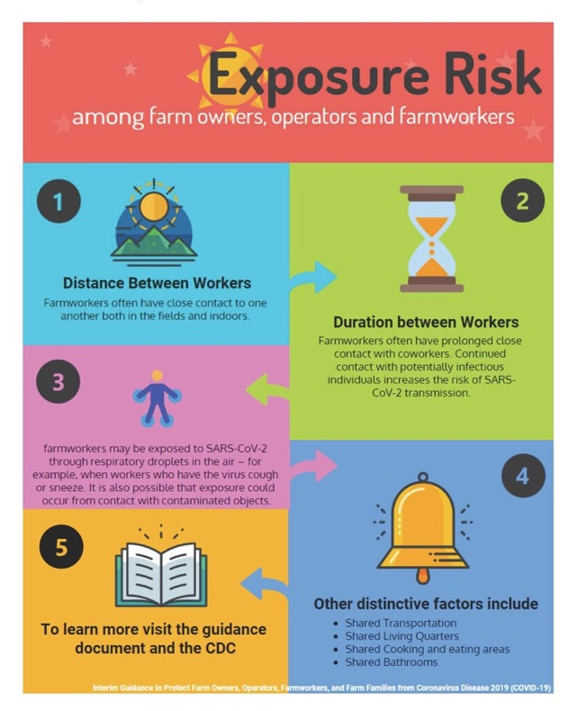
Source: CDC Agricultural Industry Guidance
Notes:
The CDC has issued guidance to protect farm owners, operators, workers and families from Coronavirus Disease 2019 (COVID-19). There is no evidence that livestock, crops, or product that workers involved in production agriculture may handle are a source of SARS-CoV-2 infection. However, close contact with coworkers in their work environments may contribute to their potential exposures. For more information visit https://www.cdc.gov/coronavirus/2019-ncov/prevent-getting-sick/how-covid-spreads.html. #farmers #COVID19 #farmsafety #CultivateSafety #farmers #COVID19 #farmsafety #CultivateSafety . #COVID19 #farmsafety #USAgCenterSafety #agsafetytips #coronavirus

Slide 27
Source: CDC/NIOSH Agricultural Industry Guidance
Notes:
Hang posters where your farm workers can see them. CDC has free, simple posters available to download and print, some of which are translated into different languages. Get posters at https://bit.ly/CDCPOSTERS. #COVID19 #farmsafety #USAgCenterSafety #agsafetytips #coronavirus

